Slide 1
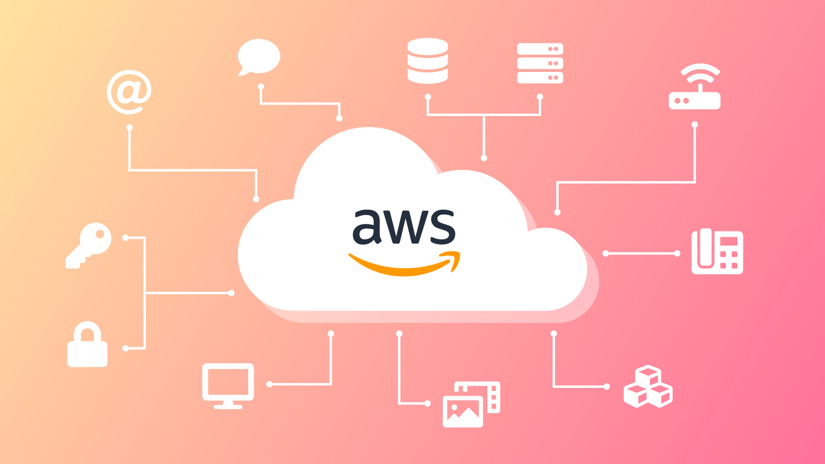
Amazon ElastiCache for Redis

Slide 2
What is Amazon ElastiCache?
Amazon ElastiCache is a fully managed, in-memory caching service that supports two open-source caching engines: Redis and Memcached.
Purpose: ElastiCache helps improve application performance by retrieving data from high throughput and low latency in-memory data stores, reducing the need to retrieve data from slower disk-based databases.
Key Features:
Managed Service: AWS handles maintenance, patching, and scaling, so you can focus on your application.
High Availability: Supports Multi-AZ with automatic failover and backup and restore capabilities.
Scalability: Easily scale in and out with no downtime by adding or removing nodes from your Redis cluster.

Slide 3
What is Redis?
Redis (Remote Dictionary Server) is an open-source, in-memory data structure store, used as a database, cache, and message broker.
Core Features:
In-Memory Storage: Stores data in memory for extremely low latency and high performance.
Data Structures: Supports various data types like strings, hashes, lists, sets, sorted sets, bitmaps, and hyperloglogs.
Persistence: Redis supports point-in-time backups (snapshots), and logs of all writes to disk (AOF - Append Only File).
Replication: Supports master-slave replication, allowing data to be duplicated across multiple Redis instances.

Slide 4
Use Cases for Redis
Caching: Speeds up applications by caching frequently accessed data, reducing the load on the primary database.
Session Store: Manages user sessions in web applications, providing fast read/write access to session data.
Real-time Analytics: Processes and analyzes large streams of data in real-time.
Pub/Sub Messaging: Redis can be used for messaging between different components of an application.

Slide 5
Key Features of Amazon ElastiCache for Redis
Fully Managed Service:
Automatic Scaling: Automatically scales clusters in and out based on demand, maintaining performance while minimizing cost.
Maintenance and Patching: AWS handles all updates, patching, and hardware replacements, ensuring your Redis clusters are up-to-date and secure.
Monitoring and Alerts: Integrated with Amazon CloudWatch for monitoring key metrics such as CPU utilization, memory usage, and connection count.

Slide 6
High Availability and Disaster Recovery:
Multi-AZ Deployments: Supports Multi-AZ with automatic failover to ensure high availability.
Automatic Failover: In the event of a primary node failure, Redis can automatically promote a replica to minimize downtime.
Backup and Restore: Automated backups allow you to restore your Redis data from a specific point in time, ensuring data durability.
Security:
Encryption: Supports encryption at rest and in transit to protect your data.
VPC Integration: Launch your Redis clusters within a Virtual Private Cloud (VPC) to isolate your cache from the internet and secure it further.
IAM Policies: Use Identity and Access Management (IAM) to control access to your Redis clusters.

Slide 7
How Amazon ElastiCache for Redis Works
Cluster Architecture:
Nodes: Each Redis node is an independent Redis server instance.
Shards: A Redis cluster is composed of one or more shards, with each shard containing a subset of the dataset.
Replication Groups: A replication group contains the primary node and one or more replica nodes, ensuring data redundancy.
Data Partitioning:
Hash Slot Partitioning: Redis automatically partitions data across shards using hash slots, distributing keys evenly across the cluster.
Replication: The primary node in each shard replicates data to one or more replica nodes for high availability.

Slide 8
Read/Write Operations:
Writes: All write operations are directed to the primary node in each shard, which then replicates the changes to its replicas.
Reads: Read operations can be directed to either the primary node or any of its replicas, distributing the read load and improving performance.
Failover Process:
Automatic Promotion: In case of a primary node failure, ElastiCache automatically promotes one of the replicas to become the new primary.
Client Reconnection: Applications using Redis will automatically reconnect to the new primary, minimizing disruption.

Slide 9
Benefits of Using Amazon ElastiCache for Redis
Performance Improvement:
Low Latency: In-memory caching provides sub-millisecond latency, significantly speeding up application response times.
High Throughput: Redis can handle millions of requests per second, making it suitable for high-traffic applications.
Cost Efficiency:
Offload Database: By caching frequently accessed data, ElastiCache reduces the load on your primary database, potentially lowering costs associated with database scaling.
Elastic Scaling: Scale your Redis clusters dynamically based on demand, paying only for what you use.

Slide 10
Ease of Use:
Simple Setup: Launching a Redis cluster with ElastiCache takes just a few clicks from the AWS Management Console.
Automatic Failover: Built-in failover capabilities reduce the need for manual intervention, simplifying operations.
Integration with Other AWS Services:
Amazon RDS: Use Redis as a cache in front of Amazon RDS (Relational Database Service) to improve query performance.
AWS Lambda: Integrate Redis with AWS Lambda for real-time data processing.
Amazon CloudWatch: Monitor Redis metrics using CloudWatch, allowing for proactive management of your cache.

